Slide 1
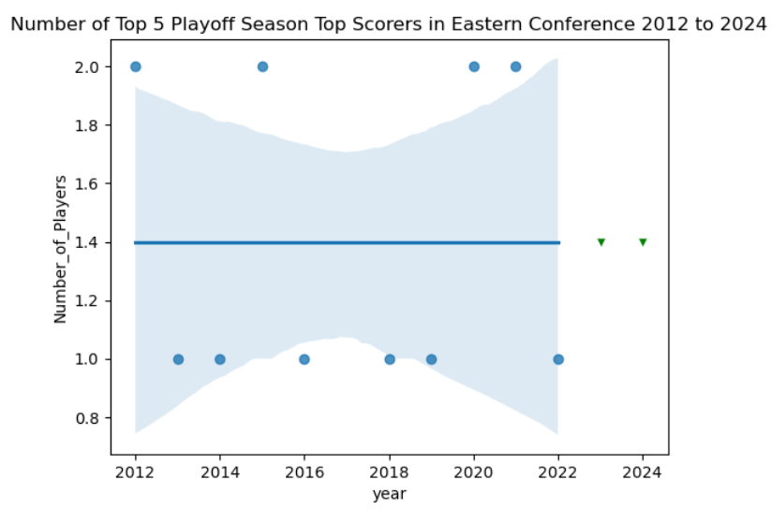
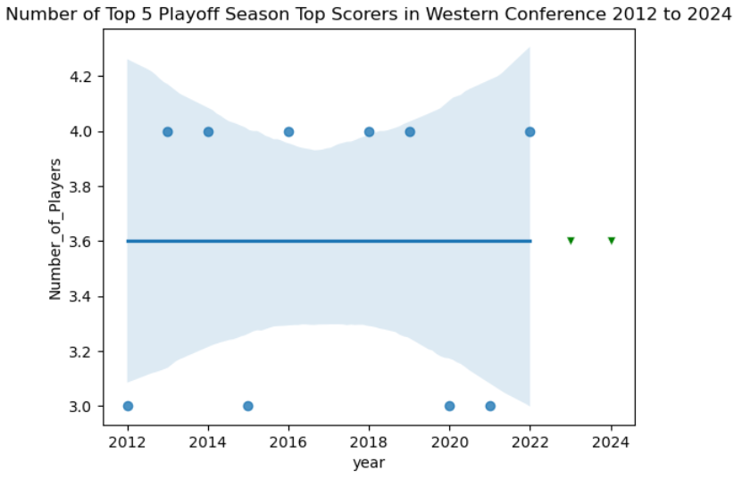
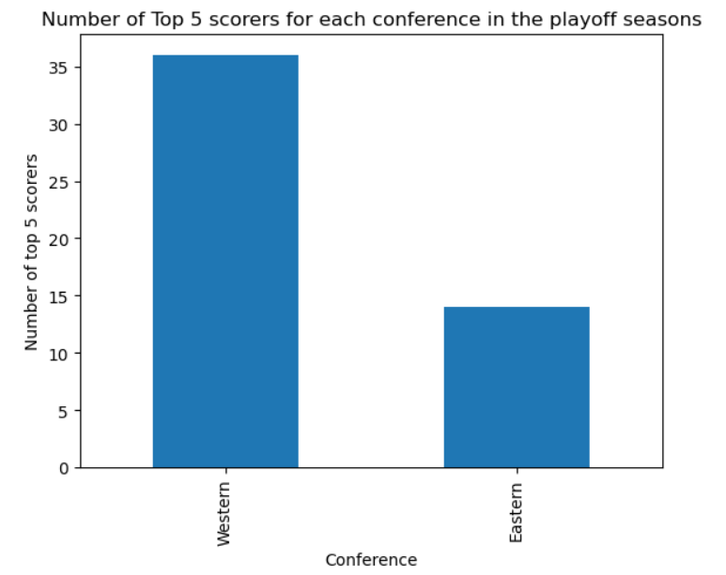
Competitive Differences Between NBA Western vs. Eastern Conferences
Kidus Yohannes, Tony Giech, Zekai Peng, Jonathan Hong
Northeastern University – DS3000 Foundations of Data Science
ABSTRACT
METHODOLOGY
THE IMPACTS
This project explores the competitive differences between the NBA's Western and Eastern Conferences over the last 10 seasons. By analyzing all-star selections, NBA honors, and Finals victories, we aim to determine if one conference exhibits superior competitiveness. Utilizing k-NN, Random Forest, and SVM algorithms, our methodology includes rigorous data preparation and model evaluation to ensure robust analysis. The findings suggest significant variances in the competitiveness of conferences, potentially influencing playoff chances and raising fairness concerns within the league's structure. This abstract encapsulates the project's essence, methodology, results, and potential impacts on various NBA stakeholders.
For this project, we initially looked at data from a dataset we found on Kaggle that contained stats from the NBA starting in the year 2012 to the year 2023. Before we could use this data however, we had to perform EDA by first checking the "head" or first five entries in the dataset. Then we checked for any null/missing data of which we found none. Then we checked to make sure that the data was in its appropriate form such as player's names being strings, points per game being integers, etc. In the dataset, we found columns containing data for each player such as average pointers per game of the season, average assists per game of the season, and average rebounds per game of the season among other stats. We also made sure there were no duplicates or outliers in our data as that could potentially skew the results. Once the preliminary analysis was complete, we decided that we would isolate the top 5 scorers per year, the top 5 playoff scorers per year, and the top 5 All-Star scorers per year. If the majority of the top 5 players for each of the three categories (scorers per year, playoff scorers per year, and All-Star scorers per year) were from one conference over another, that would be an indicator that one conference is more competitive than the other as most of the top players are concentrated in that conference.
Once we isolated the top 5 players for each of the three categories we previously decided on, we visualized the data by creating three bar graphs to show the number of appearances each of the conferences had in the top 5 scorers for each of the three categories. We then used the datasets for each of the categories and separated it by conference and created line plots, scatter plots, and a line of best fit for the scatter plots to help us see trends in the data. To take this a step further, we also created Linear Regression models by using and reshaping the data used for the scatter plots and the line of best fit. These models then predict the number of players that would be in the top 5 scorers for both conferences for the regular season and the playoffs for the next two years. For all of these models and visualizations, we focused a lot on the relationship between time (each season specifically) and the number of players per conference because if a conference has the majority of the top 5 scorers over multiple seasons consistently, then that could be an indicator that specific conference is more competitive.
To further aid us, we also decided to create three supervised learning models, specifically K-NN, Random Forest, and SVM. We focused on 'PTS', 'year', 'Conference', and 'season_type' for our variables with 'PTS' being the points each player scored per season, 'Conference' being the Eastern and Wsetern conferences, and 'season_type' would be the regular season, playoff season, and the All-Star game. By focusing on these variables it would show which conference has better players and that would help determine which conference is more competitive. Due to these models being predictive, we split up our data into training and testing sets for each of the models. The training sets would help us build the model by "training" it on the training set data and we would then tests it accuracy in making predictions using the test sets. We then used GridSearchCV for each of our models to optimize their hyperparameters in order to tweak our model for more accuracy and then we retrained our model with the new adjustments.
The NBA Finals is always the top Eastern conference team versus the top Western conference team meaning that the series may not be between the top two teams in the league that season. Thus, if one conference has a generally more competitive pool, teams in the other conference have an easier chance getting into the playoffs which raise questions about fairness as the conferences are not matched up as evenly as they can be. For instance, in 2000, the 8th seed Indiana Pacers had a 41-41 record while two Western conference teams, the Houston Rockets and Seattle Supersonics missed the playoffs despite having 45-37 and 44-38 records respectively. Another potential impact of this structure can be seen with the NBA All-Star game, which was changed from an East vs. West format to team captains, in which either team could have both Eastern and Western players. This has since received positive feedback due to the format resulting in more interesting games which in turn raises questions about entertainment value, fan engagement, and revenue. This is because even though the NBA uses a revenue sharing format, "to receive full revenue sharing benefits, the revenue structure requires small market teams to generate revenue equal to at least 70% of the league average." Therefore, if some small market teams are stuck in a less competitive conference with less entertaining games, this could impact their revenue and may lead to them missing the 70% threshold. Moreover, the salary cap used to pay players is also based on revenue meaning that if the NBA is not living up to its potential entertainment value, players' salaries would be affected which could lead to things like strikes.
INTRODUCTION & OBJECTIVES
Defining the Question
For this project, we aim to answer the question, “Is the Western conference more competitive than the Eastern conference in the NBA?” Some relevant facts to contextualize why we would like to explore this topic include that the league’s Finals series is always top Eastern conference team vs. top Western conference team, not necessarily the top two teams of the season. Thus, if one conference has a generally more competitive pool, teams in the other conference have an easier chance getting into playoffs, raising questions about fairness if the conferences are not matched up as evenly as they can be. Another example of the impacts of this structure can be seen with the NBA All-Star game, which was changed from an East vs. West format to team captains, in which either team could have Eastern or Western players, and has received positive feedback for more interesting games. We understand that there is a ton of data that can be gathered on this topic, therefore we plan to limit our scope to the last 10 seasons of the NBA. By limiting our timeline to the last 10 seasons, we keep the data as close to the present as possible allowing for a more accurate analysis of the current state of competitiveness between conferences.
Objectives
While there are many potential metrics of competitiveness between the two conferences, such as the number of all-star selections and all NBA honors from each conference per season, the head-to-head stats of the top teams from each conference, and the number of times the Western conference won the NBA finals versus the number of times the Eastern conference won the NBA finals, we will focus on using average points scored to look for competitive differences between the two conferences. Other head-to-head stats of the top teams such as rebounds, steals, blocks, etc. are also stats that can be used as a supplement to points scored. Our primary focus is to attempt to find a connection between average points scored per year and conference. Using insights gathered from these data fields, our goal is to draw conclusions about the potential differences in competitiveness between the Western and Eastern Conferences and the implications of those differences on the NBA structure.
Motivations and Related Work
Our catalyst for initially choosing to explore the NBA was our shared love of basketball. However, we soon discovered that by exploring which conference is more competitive, we can gain valuable insights into the performance trends of teams, players, and ultimately uncover the factors that contribute to a team's competitiveness. This research not only serves to satisfy the curiosity of basketball enthusiasts like us, but it also has practical applications in team management, fan engagement, and sports betting. It's a fascinating opportunity to leverage data-driven techniques to enhance our understanding of the NBA.
The above are the visualizations of the predictions made by our Linear Regression Model for Playoff Scorers for each conference. We can see that the Western Conference consistently has most of the top 5 playoff scorers.
RESULTS & EVALUATION
CONCLUSION
Based on these statistics shown by our EDA, it seems as though the Western Conference has significantly more top scorers in the league, which appears to be a competitive imbalance. As shown in the figure on the right, the number of top 5 scorers in the playoff seasons of the last ten years is made up considerably more of Western Conference players compared to Eastern Conference, and the regular and all-star seasons yielded similar results. Our Linear Regression Model also seemed to show a competitive imbalance with the Western Conference having the edge. It must be noted in recent years, the Eastern Conference has most of the top 5 regular season scorers and this might be a sign of a switch in the power imbalance with the East now becoming the more competitive conference. Despite that, we can still clearly see that the West outperforms the Eastern conference significantly in terms of top 5 playoff scorers and have done so for almost all of the last 10 years. However, our machine learning models yielded only about a 49-52% accuracy score, which does not show a significant correlation between points and conference. We also noted that the mean training scores returned from GridSearchCV were not much higher than the test scores, except for Random Forest, ranging from 53-85%. As such, it seems that we have underfit our data, and we can consider adding more features to create more complex models to classify conference. Some possible explanatory variables in the original dataset that could be added to the models are efficiency, assists, steals, and blocks. Including these variables could help to better represent the skill of each player, both offensively and defensively, and provide a more complex model with the potential of fitting the data better.
Thanks to this project, we were able to apply what we learned in class to an issue we were passionate about as basketball fans that has real world implications. We examined the trends of variables such as "points" and how it relates to competitiveness for each NBA conference. In short, answering the question of which conference is more competitive is more than just a hypothetical posed by basketball enthusiasts but is a topic that has consequences that affect one of the largest sports leagues in the world and the numerous local economies, players, staff, and fans that it serves. This issue has been an ongoing debate among various sectors involved in the NBA league, and should be seriously considered for the longevity of the NBA structure, as they have real impacts on players and fans.
REFERENCE
Heffernan, Brendan. “NBA Eastern Conference vs. Western Conference (Differences).” Dunk or Three, Dunk or Three, 22 Sept. 2021, dunkorthree.com/nba-eastern-western-conferences/.
Nath, Trevir I. “The NBA’s Business Model.” Investopedia, Investopedia, 10 Sept. 2021, www.investopedia.com/articles/investing/070715/nbas-business-model.asp#:~:text=Revenue%20sharing%20in%20the%20NBA%20addresses%20the%20inequitable,revenue%20equal%20to%20the%20salary%20cap%20that%20year.
“How Economics Effects the NBA.” HoopSocial, HoopSocial, 9 May 2023, hoop-social.com/how-economics-effects-the-nba/#google_vignette.

